Slide 1
Onsite progress
Zeyuan Yu
2025-02-03

Slide 2
Filling
Water filling
Reached 43.5m at lunch time on Feb. 1.
But due to a FOC liquid-sensor problem in the WP, WP was filled to ~44m, 0.5m higher than design at about 9:00pm Feb. 1
Water entered the cable trench and alarmed sent by Jinchang’s apparatus
We stop water filling in the late evening on Feb. 1 and started to drain the cable trench
Now, 43.5m water in CD and WP; WP water circulation started
5cm residual water in the trench
No severe problem was found till now

Slide 4
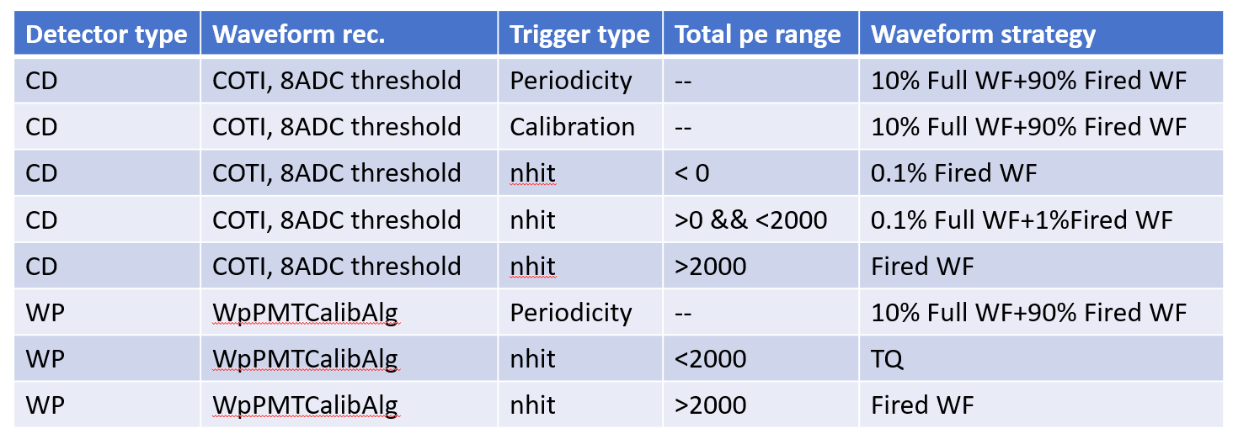
Run NO | Date | CTU CD | CTU WP | OEC | HV
3231 | 0202, 0.5h | 100Hz calib + nhit thre 700, laser at 16m | NO | COTI; Water OEC | HV full water
3232 | 0202, 5m | Laser moving run, 16m to 10m, nhit thre 700 | NO | COTI; Water OEC
3233 | 0202, 0.5h | 100Hz calib + nhit thre 700, laser at 10m | NO | COTI; Water OEC
3234 | 0202, 11m | Laser moving run, 10m to 0m, nhit thre 700 | NO | COTI; Water OEC
3235 | 0202, 30m | 100Hz calib + nhit thre 700, laser at 0m | NO | COTI; Water OEC
3236 | 0202, 11m | Laser moving run, 0m to -10m, nhit thre 700 | NO | COTI; Water OEC
3237 | 0202，30m | 100Hz calib + nhit thre 700, laser at -10m | NO | COTI; Water OEC
3238 | 0202, 11m | Laser moving run, -10m to -16m, nhit thre 700 | NO | COTI; Water OEC
3239 | 0202, 30m | 100Hz calib + nhit thre 700, laser at -16m | NO | COTI; Water OEC
CTU has a 500us dead time after each trigger to avoid unknown spikes in the trigger rate
Nhit threshold to take muons data
WP is not running during these runs

Slide 5
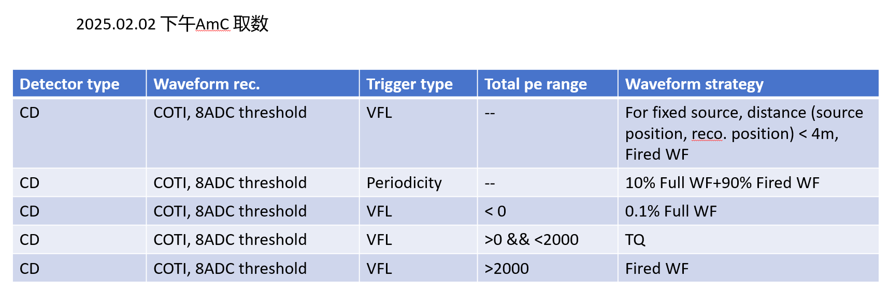
Run NO | Date | CTU CD | CTU WP | OEC | HV
3279 | 0202, 0.5h | VFL threshold 143, AmC at 16m |  | COTI; Water OEC | HV full water
3280 | 0202, 5m | source moving run, 16m to 10m, |  | COTI; Water OEC
3281 | 0202, 0.5h | VFL threshold 143, AmC at 10m |  | COTI; Water OEC
3282 | 0202, 11m | VFL threshold 143, AmC 10m to 0m |  | COTI; Water OEC
3283 | 0202, 30m | VFL threshold 143, AmC 0m |  | COTI; Water OEC
3286 | 0202, 30m | VFL threshold 143, AmC -10 m |  | COTI; Water OEC
3293 | 0202, 30m | VFL threshold 143, AmC -16 m |  | COTI; Water OEC
CTU has a 500us dead time after each trigger to avoid unknown spikes in the trigger rate

Slide 6
Run NO | Date | CTU CD | CTU WP | OEC | HV
3322 | 0202, 1h | Physics run |  |  | HV full water
3323 | 0203, 50m | Physics run
3326 | 0203,6h | Physics run
CTU has a 500us dead time after each trigger to avoid unknown spikes in the trigger rate

Slide 7
Run NO | Date | CTU CD | CTU WP | OEC | HV
3333 | 0203, 0.5h | VFL threshold 143, AmBe at 16m |  | COTI; Water OEC | HV full water
3335 | 0203, 0.5h | VFL threshold 143, AmBe at 10m |  | COTI; Water OEC
3338 | 0203, 30m | VFL threshold 143, AmBe 0m |  | COTI; Water OEC
3340 | 0203, 30m | VFL threshold 143, AmBe -10 m |  | COTI; Water OEC
3342 | 0203, 30m | VFL threshold 143, AmBe -16 m |  | COTI; Water OEC
3371 | 0203, 30m | Calibration 100Hz laser |  | COTI; Water OEC
 |  |  |  | COTI; Water OEC
CTU has a 500us dead time after each trigger to avoid unknown spikes in the trigger rate

Slide 8
Run NO | Date | CTU CD | CTU WP | OEC | HV
3380 | 0203 | First WP LED run |  | COTI; Water OEC | HV full water
3382 | 0203 | Second WP LED run |  | COTI; Water OEC
3384 | 0203 | Third WP LED run |  | COTI; Water OEC
3385 | 0203 | WP LED run for attenuation length |  | COTI; Water OEC
 |  |  |  | COTI; Water OEC
 |  |  |  | COTI; Water OEC
Save fired waveform for WP PMTs. |  |  |  | COTI; Water OEC

Slide 9
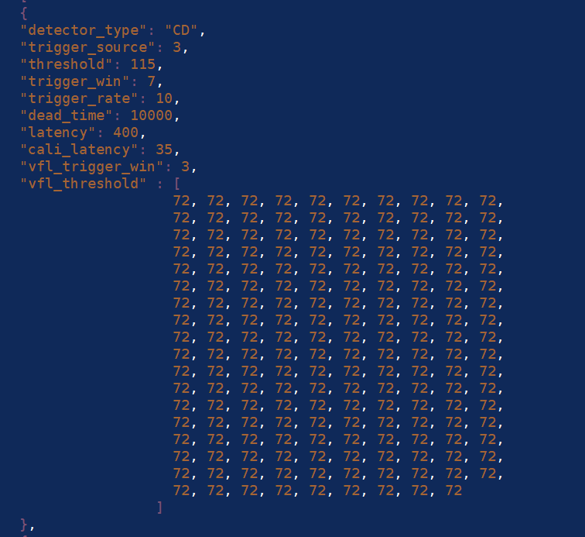
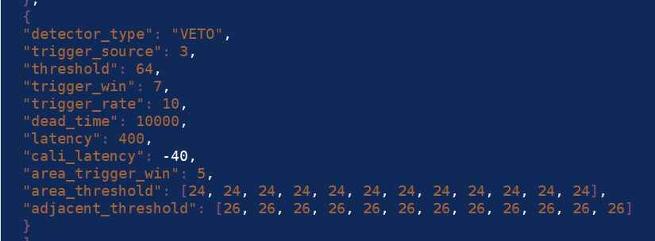
0204 overnight runs
Run NO | Date | CTU CD | CTU WP | OEC | HV
3413 | 0204 2.5h |  |  | COTI; Water OEC | HV full water
3415 | 0204 1h |  |  | COTI; Water OEC
3416 | 0204 3h |  |  | COTI; Water OEC

Slide 10
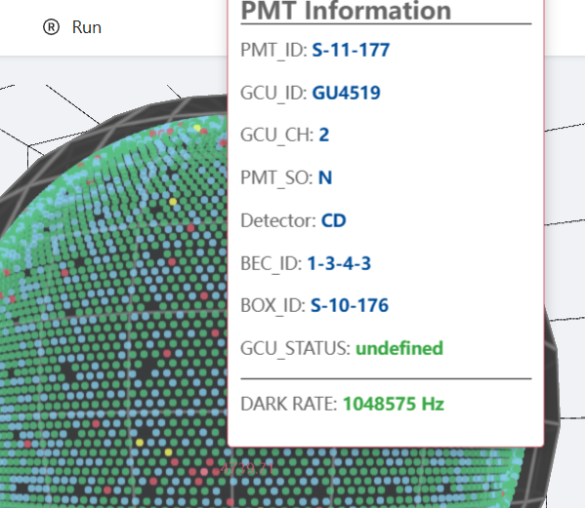
Flashers
LPMT with dark count rate > 1 MHz
Releasing photons shining the nearby LPMTs
After reducing the PMT HV to 800V, the nearby PMTs become quite.

Slide 11
GCU ID-ch | Date | Original HV | HV in runs | PMT type
GU0821，ch3 | 1月20日左右 |  | 800V | N
GU6837，ch1 | 1月23-27日 | 1621V | 800V | N
GU3872，ch2 | 1月25日左右 | 1644V | 800V | N
GU5658，ch3 | 1月26日 | 1630V | 800V | N
GU2006，ch3 | 1月26日 | 1640V | 800V | N
GU2277，ch3 | 1月26日 | 1640V | 800V | N
GU0785，ch2 | 1月28日 | 1718V | 800V | N
GU3634，ch2 | 1月30日 |  | 800V | N
GU5978，ch3 | 2月1日 | 1631V | 800V | N
GU1582, ch1 | 多次 | 1400V | 800V | N
GU0880 ch3 | 2月2日 | ？ | 800V
GU4374，ch1 | 2月2日 | ？ | 800V
GU 1090 ch2 | 2-2 |  | 800V
13 LPMTs

Slide 12
GCU ID-ch | Date | Original HV | HV in runs | PMT type
GU5613 ch3 | 2-2 |  | 800V
GU6297 ch3 | 2-2 |  | 800V
GU7216 ch1 | 2-2 |  | 800V
GU4483 ch3 | 2-2 |  | 800V
gu1759 ch2 | 2-2 |  | 800V
Gu6672 ch3 | 2-2 |  | 800V
GU3123 ch3 | 2-2 |  | 800V
GU6672 ch3 | 2-2 |  | 800V
GU6828 ch2 | 2-2 |  | 800V
GU3119 ch1 | 2-2 |  | 800V
GU6354 ch2 | 2-2 |  | 800V
11 LPMTs

Slide 13
`
GCU ID-ch | Date | Original HV | HV in runs | PMT type
GU 6842 ch3 | 2-2 |  | 800V
GU 3197 ch1 | 2-2 |  | 800V
GU 0758 ch1 | 2-2 |  | 800V
GU 0857 ch3 | 2-2 |  | 800V
GU 1895 ch3 | 2-2 |  | 800V
gu3547 ch2 | 2-2 |  | 800V
GU6518 ch1 | 2-2 |  | 800V
GU6876 ch1 | 2-2 |  | 800V
GU4854 ch1 | 2-2 |  | 800V
GU3101，ch3 | Trip, can not recover
GU4717 ch2 | Trip, can not recover
11 LPMTs

Slide 14
GCU ID-ch | Date | Original HV | HV in runs | PMT type
GU 2902 ch3 | 2-3 |  | 800V
GU5835 ch3 | 2-3
GU0786 ch3 | 2-3
GU2049 ch2 | 2-3
GU7357 ch1 | 2-3
GU6664 ch2 | 2-3
GU2049 ch2 | 2-3
GU0786 ch3 | 2-3
GU 3097 ch2 | 2-3
GU2520 ch2 | 2-3 |  | 800V
GU 2835 | dead
11 LPMTs
Will keep burning these PMTs at low HV and hope they can recover

Slide 15
Run NO | Date | CTU CD | CTU WP | EMF coil | OEC | HV
2220$ Problem | 0119, 30m | Nhits + 500 Hz period |  | On | On, fired PMT wave | HV 1.1
2277 | 0120, 20m | Calibration, 25 Hz |  | On | Off, all waveform | HV 1.1
2280 | 0120, 18m | Calibration, 25 Hz |  | On | Off, all waveform | HV 1.1 - 40V
2283 | 0120, 18m | Calibration, 25 Hz |  | On | Off, all waveform | HV 1.1 - 80V
2315 Test | 0120, 60m | Nhit 185 thres + 200 Hz period, total 1kHz | Nhit 60 thre. + 10Hz Period | On | On, fired PMT wave | HV 1.1 *
2320 Test | 0120 | Nhit 185 thres + 200 Hz period, total 1kHz | Nhit 60 thre. + 10Hz Period | On | On, fired PMT wave | HV 1.1 *
2410 Good | 0121, 20m | Nhit 170 thres + 10Hz period; SWTrig on # | Nhit 45 thre + 10Hz period | On | On, fired PMT wave | HV 1.1
2447 good | 0122, 30m | Nhit 200 thres + 10Hz period; SWTrig on | Nhit 65 thre + 500Hz period | On | On, fired PMT wave | HV 1.2
2453 good | 0122, 16m | Nhit 200 thres + 10Hz period; SWTrig/MM on | Nhit 65 thre + 500Hz period | On | On, fired PMT wave | HV 1.2
DAQ readout window 1008ns. Normal HV pasted at https://juno.ihep.ac.cn/elog/Commissioning/67 $ A complicated bug was found in the trigger-DAQ-OEC configuration chain. This run is not good. Experimental hall light off at 19:20 Jan. 20. Later electronics rooms light off * three candidate flashers, GU6940 ch3 – 100V; GU2276 ch3 -100V at 19:30；GU4329 ch1 -250V at 19:48; # SWTrig is software trigger running at DAQ side. It has 128 ns coincidence window and nhit threshold 200 in run 2410 HV 1.2: reduce HV for high gain PMTs by 40/80V, increase some low gain PMT HV by 40V, provided by Weng Jun. Paste at elog/Commissioning/6x

Slide 16
Run NO | Date | CTU CD | CTU WP | EMF | OEC | HV
2487 good | 0124 | Nhit thre 170 + 10Hz | Nhit 52 + 10Hz | on | COTI; total pe>2000 save fired waveform; | HV 1.2
2590 | 0125 | ~Nhit thre 120 + 10Hz GCU threshold 15 | ~Nhit 50 + 10Hz | On | COTI; total pe>2000 save fired waveform; | HV 1.3
2598 | 0125 | ~Nhit thre 120 + 10Hz GCU threshold 15 | ~Nhit 50 + 10Hz | On | COTI; total pe>2000 save fired waveform; | HV 1.3 + 20V
2599 | 0125 | ~Nhit thre 120 + 10Hz GCU threshold 13 | ~Nhit 50 + 10Hz | On | COTI; total pe>2000 save fired waveform; | HV 1.3 – 30V
2600 | 0125 | ~Nhit thre 120 + 10Hz GCU threshold 11 | ~Nhit 50 + 10Hz | On | COTI; total pe>2000 save fired waveform; | HV 1.3 – 60V
2601 | 0125 | ~Nhit thre 120 + 10Hz GCU threshold 11 | ~Nhit 50 + 10Hz | On | COTI; total pe>2000 save fired waveform; | HV 1.3 – 90V
Changelog HV 1.3: 1) Update circle s25 configuration by LPMT group; 2) GU0821-ch3, reduce HV to 1400V; GU3119-ch1, reduce HV to 1400V; 3) Fine tune about 100 LPMTs, high gain ones – 40V, low gains ones +30V and +50V, provided by Runze; 4) manually configure GCU-6837-ch1 reduced to 1400V; GCU-1582-ch1 reduced by 50V; GCU-6828-ch2, reduced by 50V; GCU-2047-ch3 reduced by 50V GCU-3872-ch2 reduced to 1600V, still flashes, reduce to 1400V

Slide 17
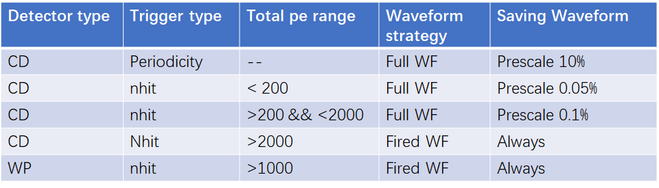
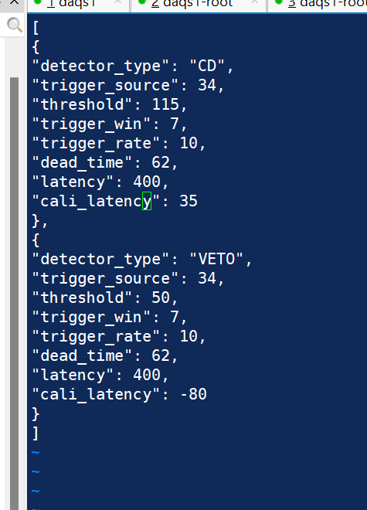
n
Run NO | Date | CTU CD | CTU WP | EMF | OEC | HV
2640 | 0126 | Nhit thre ~115 + 10Hz | Nhit ~50 + 10Hz | on | COTI; details below | HV 1.3
2642 | 0126 | Nhit thre ~115 + 10Hz | Nhit ~50 + 10Hz | On | COTI; details below | HV 1.3
2648 | 0126 | Nhit thre ~115 + 10Hz | Nhit ~50 + 10Hz | On | COTI; details below | HV 1.3
HV 1.3: Reduce HV for flasher candidate: GU5658-ch3, GU2006-ch3, GU2277-ch3, GU6828 ch2, GU1582 ch1, GU6354 ch2 to 1400V

Slide 18
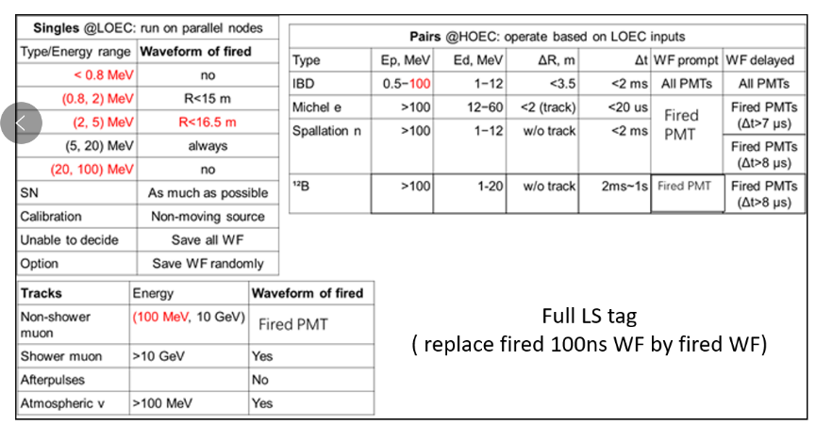
n
Run NO | Date | CTU CD | CTU WP | EMF | OEC | HV
2705 | 0127, 2h | Nhit thre ~115 + 10Hz | Nhit ~50 + 10Hz | on | COTI; LS OEC configuration | HV 1.3
2725 | 0127, | nHit thre~300, laser on at 50Hz w/o calibration trigger | Nhit ~50 + 10Hz | On | COTI; LS OEC configuration | HV 1.3
2759 | 0127, 10h | Good for electronics noise studies |  | On | COTI; LS OEC configuration | HV off
HV 1.3: Reduce HV for flasher candidate: GU5658-ch3, GU2006-ch3, GU2277-ch3, GU6828 ch2, GU1582 ch1, GU6354 ch2 to 1400V

Slide 19
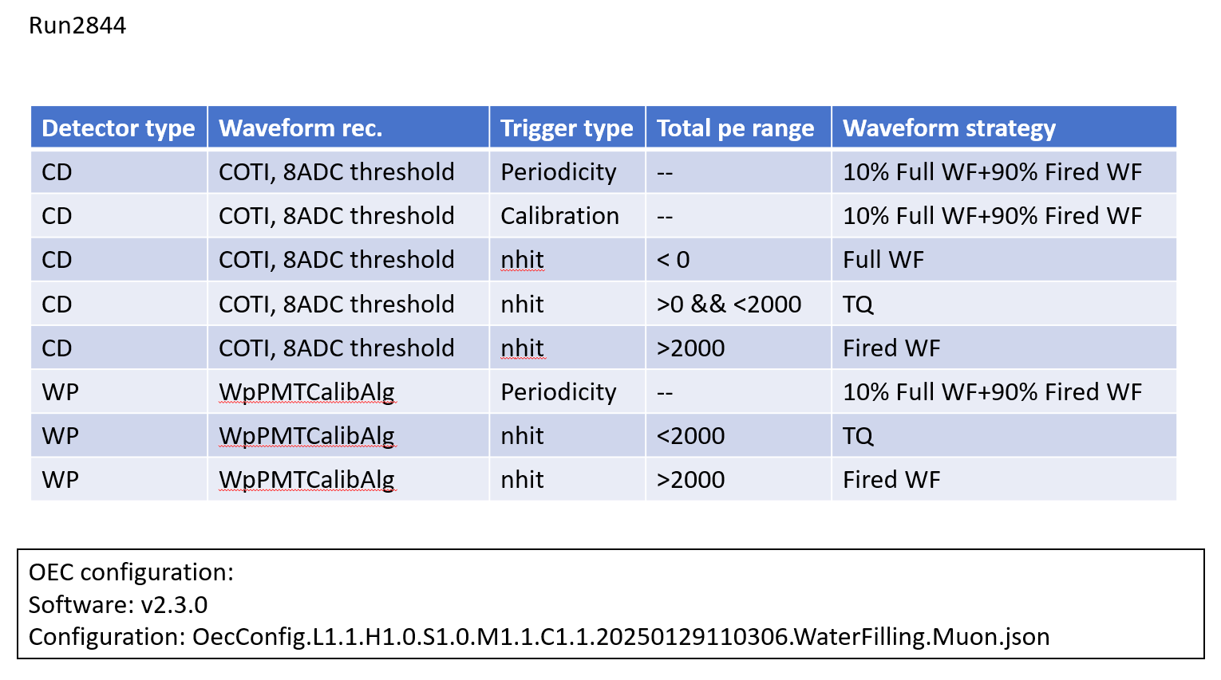
Run NO | Date | CTU CD | CTU WP | OEC | HV
2844 | 0129,25m | Nhit thre ~ 88 + 10Hz period | Nhit ~55 + 10Hz | COTI; Water OEC | HV 1.3
2856 | 0129, 1h | VFL, thre 70 + 10Hz period | Nhit ~60 + 10Hz period | COTI; Water OEC | HV 1.3
2873 | 0129, 1h | VFL, thre 70 + 10Hz period | Nhit ~60 + 10Hz period | COTI; Water OEC | HV 1.3

Slide 20
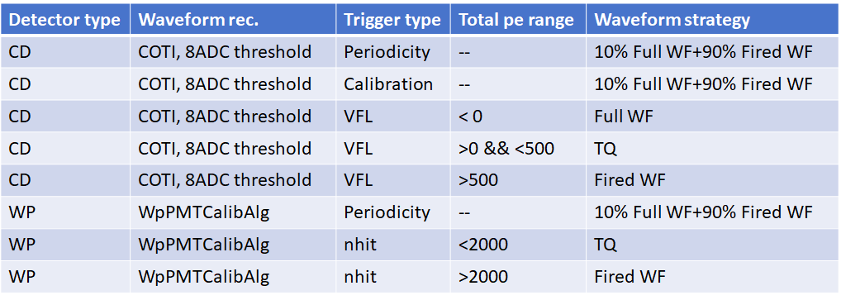
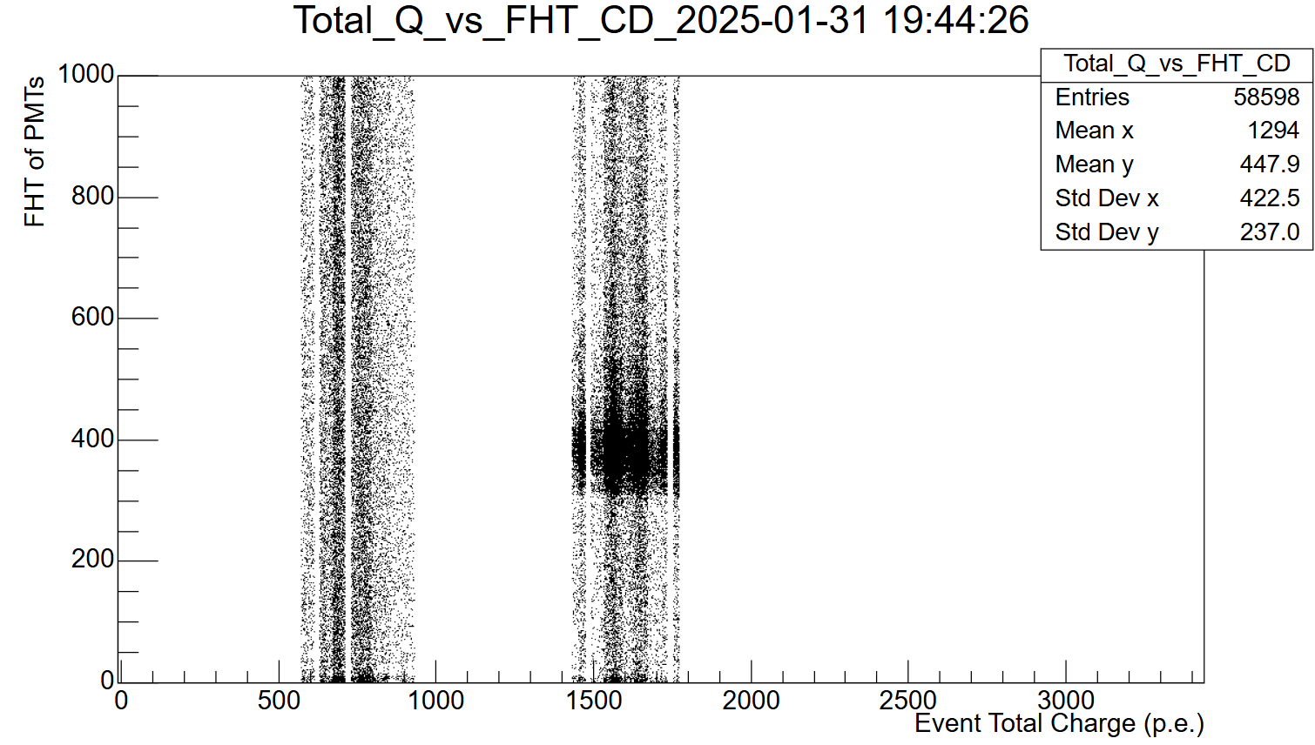
Run NO | Date | CTU CD | CTU WP | OEC | HV
2988 | 0131, 2h | VFL thre ~ 89 + 10Hz period | Regional + 10Hz | COTI; Water OEC | HV 1.3
2996 | 0131, 0.5h | 100Hz laser at 0m | Regional + 10Hz period | COTI; Water OEC | HV 1.3
3000 | 0131, 20m | Source moving run VFL thre ~ 89 + 10Hz period | Regional + 10Hz period
3002 | 0131, 0.5h | 100Hz laser at -14m | Regional + 10Hz period | COTI; Water OEC | HV 1.3
3010 | 0131, 40m | Source moving run VFL thre ~ 89 + 10Hz period | Regional + 10Hz period | COTI; Water OEC | HV 1.3
3030 | 0131, 0.5h | 100Hz laser at 14m | Period 500Hz | COTI; Water OEC | HV 1.3
3045 | 0131，1.5h | 800Hz period | 500Hz period | COTI; Water OEC * | HV 1.3
In run 3030, the total pe~1800 is laser event. 500-1000 is unknown CTU problem from CTU

